Slide 1
Quality assessment in Health and Physical Education
Primary years workshop

Slide 2
Workshop outcomes
Investigate the challenges in implementation of Health and Physical Education in primary schools
Develop understanding of Health and Physical Education curriculum to support effective planning and teaching
Develop a model of planning and collaboration between primary school PE teachers and classroom teachers to ensure consistent assessment judgements
Provide practical school-based strategies for quality assessment processes in Health and Physical Education.

Slide 3
Workshop overview – Day 1
Unpacking HPE curriculum
Current pictures of teaching and assessment
Staff responsibility for teaching aspects of HPE
A-E standards within the context of HPE
Modelling a planning process for teaching and assessment in HPE

Slide 4
Workshop overview – Day 2
Practical strategies for assessing in Health and Physical Education
Planning processes to support quality assessment in Health and Physical Education
Collaborative development of units of work and assessment activities
Group sharing of products
A plan for action for returning to school.

Slide 5
Unpacking the Health and Physical Education curriculum
Session 1

Slide 6
Quick quiz

Slide 7
Assumptions and expectations
every year F-10
both strands of equal weighting
broad range of learning experiences

Slide 9
Focus areas
Health | Movement
Alcohol and other drugs | Active play and minor games
Food and nutrition | Challenge and adventure
Health benefits of physical activity | Fundamental movement skills
Mental health and wellbeing | Games and sports
Relationships and sexuality | Lifelong physical activities
Safety | Rhythmic and expressive movement

Slide 10
Sub-strands and themes
Being healthy, safe and active Identities Changes and transitions Help-seeking Making healthy and safe choices | Moving our body Refining movement skills Developing movement concepts and strategies
Communicating and interacting for health and wellbeing Interacting with others Understanding emotions Health literacy | Understanding movement Fitness and physical activity Elements of movement Cultural significance of physical activity
Contributing to healthy and active communities Community health promotion Connecting to the environment Valuing diversity | Learning through movement Teamwork and leadership Critical and creative thinking in movement Ethical behaviour in movement settings

Slide 11
Current pictures of teaching and assessment practice
Session 2

Slide 12
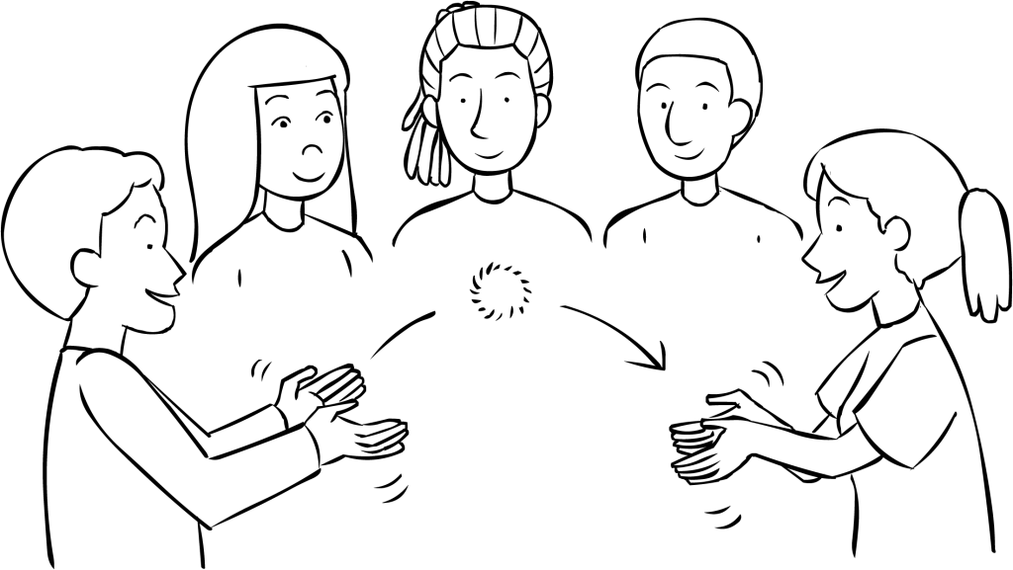
What is currently happening in your school in HPE?
Circle ball tabata – Guided discussion

Slide 13
Workshop activity
Challenges you are experiencing with assessing Health and Physical Education
Notes:
Given what it is that you want students to learn and the challenges that you want to equip them to be able to meet ... now we are going to do some critical reflection on your current programs.
I want you to think about how well you think your programs are going at equipping students ...
What are the strengths of your current program?
What areas would you like to improve?
Where are the opportunities to significantly improve or re-imagine your program delivery/offering?
What are the threats to you being able to deliver the program you want to deliver to ensure students learn what you want them to learn?

Slide 14
Workshop activity
What suggestions/solutions would you suggest for these challenges?
Notes:
Given what it is that you want students to learn and the challenges that you want to equip them to be able to meet ... now we are going to do some critical reflection on your current programs.
I want you to think about how well you think your programs are going at equipping students ...
What are the strengths of your current program?
What areas would you like to improve?
Where are the opportunities to significantly improve or re-imagine your program delivery/offering?
What are the threats to you being able to deliver the program you want to deliver to ensure students learn what you want them to learn?

Slide 16
Who takes responsibility for teaching and assessing aspects of Health and Physical Education?
Session 3

Slide 17
Who teaches and assesses what, when and where are the gaps?
Notes:
Scope and sequence initial development …

Slide 18
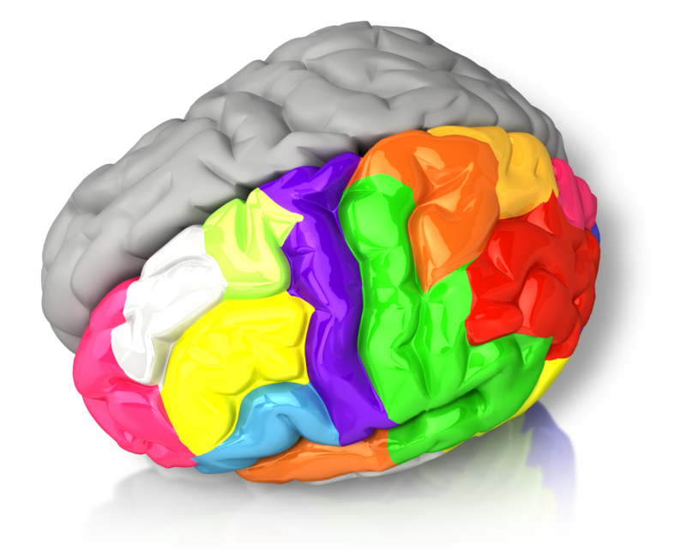
Take 5
5 squats
5 jumping jacks
5 arm circles
5 “looking for the chicken”

Slide 19
A-E within the context of Health and Physical Education
Session 4

Slide 20
So I can rank you from A-E everyone has to take the same exam: please climb that tree
Notes:
But first of all let’s reflect on what assessment is all about. A few years ago when the Federal government instigated a consistent reporting format nationally which required A-E reporting or a five-scale equivalent, there was a fair bit of misinformation that proliferated. Many teachers believed that in order to grade using an A-e or equivalent scale, every student had to perform the same tasks. Not only does this make your job in assessing students a lot more time consuming ... as the slide shows it is very unfair to students ...

Slide 21
A-E statements
A indicates that a student is performing well above the standard expected
B indicates that a student is performing above the standard expected
C indicates that a student is performing at the standard expected
D indicates that a student is approaching the standard expected
E indicates that a student is performing below the standard expected.

Slide 22
Unpacking the HPE achievement standards

Slide 23
Exploring levels of achievement (ACARA work samples)

Slide 25
Revisiting who teaches and assess what, when?
Notes:
Process for developing a scope and sequence for Health and Physical Education
Extending on the “who teaches what, when and where are the gaps activity” – school teams will be taken through a process for developing a scope and sequence for a selected year or band level. This process can then be replicated back at school with other classroom teachers to formalize programs for Health and Physical Education across K-6. (75 mins)

Slide 26
Questions?

Slide 27
Reflections on Day 1

Slide 28
Why do we assess?
To collect information about students’ learning
To make judgments about:
quality of student learning
quality of our teaching
Notes:
SO why do we assess? We assess to collect information about students’ learning in order to make judgments about the quality of student learning ... and by association ... the quality of our teaching.
The information collected can then be used to provide explicit feedback to help students improve their learning in specific areas and can inform changes and revisions to teaching programs in order to improve the way aspects of content are taught to support more effective student learning.
And this is where providing grades back to students after you mark assessments is not useful. Research shows that if a student is given a test or assignment back with a grade and then re-sits the test there is no improvement ... and in some cases there is actually a decrease in performance due to the impact on confidence that the grade caused.
If the same test or assignment is returned with grade and comments there tended to be no improvement on the whole, although some students had a slight improvement.
If however, the task was handed back with Comments only – significant improvements at all levels of achievement were shown. This shows the value of feedback – which as HPE teachers we all understand in terms of movement performance – its no different when it comes to other types of performance.

Slide 29
Assessment is about helping students to learn better ....
.... rather than just allocate a grade.
Notes:
So let’s go through some of the features of quality assessment and you can check off how many you managed to get.
It is also important to emphasise that the fundamental purpose of assessment is to improve student learning ... not just to allocate a grade or mark. Keep this in mind as you work through the activities today. So assessment must be seen as an integral part of your teaching and learning process rather than it being a separate activity where we stop learning and start assessing.

Slide 30
How do we assess?

Slide 31
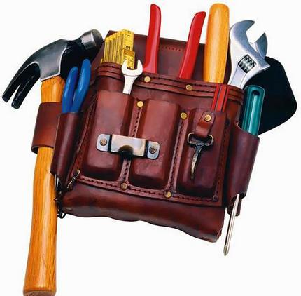
Group relay challenge
Our tools of the trade
Notes:
Post-it notes – group challenge relay ... who can come up with the most different tools for assessment.
Group them into formative / summative / both
Record a whole group list on the whiteboard – then compare in relation to efficiency, reliability, consistency of judgement

Slide 32
Assessment tools should:
be relevant (linked to standards and content)
be appropriate (measures what it intends to measure)
be fair (opportunity for all students to demonstrate what they have learnt)
be accurate (reliable and valid)
provide useful information
of learning (summative)
for learning (formative)
Notes:
This is the list of characteristics or principles that the Department believes represents quality assessment. Hopefully a lot of these are on your brainstorm list. We’re going to go in to some of these in greater detail as the presentation goes on.
But there are also a couple of features that I’d like to add in to the mix. These include ....

Slide 33
What constitutes evidence? (assessment tools)
work samples
practical performances
group presentations
group and class discussions
responses to questions
observations of students working
in-class tasks
tests
take home assignments

Slide 34
Considerations when selecting assessment tools
efficiency for you and students
reliability within class
consistency across classes

Slide 35
Planning process for teaching and assessment in HPE
From achievement standards to quality teaching, learning and assessment

Slide 36
Why start from the end?
To have clear intentions about your teaching, but also to:
...... collect information about students’ learning.....
... in order to make judgments about:
quality of student learning
quality of our teaching.
Notes:
To collect information about students’ learning in order to make judgments about the quality of student learning ... and by association ... the quality of our teaching.
The information collected can then be used to provide explicit feedback to help students improve their learning in specific areas and can inform changes and revisions to teaching programs in order to improve the way aspects of content are taught to support more effective student learning.
And this is where providing grades back to students after you mark assessments is not useful. Research shows that if a student is given a test back with a grade and then re-sits the test there is no improvement ... and in some cases a decrese in performance.
If grade and comments = no improvement on the whole – some may have slight improvement.
Comments only – significant improvements at all levels of achievement – this shows the value of feedback – which as PE teachers we all understand in terms of movement performance – its no different when it comes to other types of performance.

Slide 37
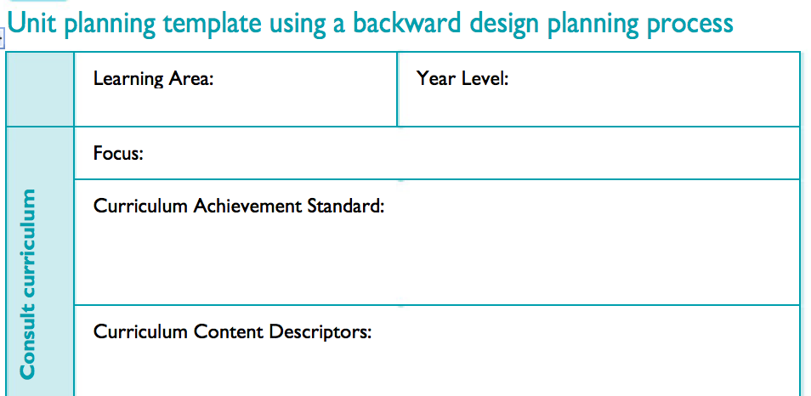
Step 1: Making sense of the standards
identify elements of the standard that could be the focus of a unit of work

Slide 38
Year 3 and 4
By the end of Year 4, students recognise strategies for managing change. They examine influences that strengthen identities. They investigate how emotional responses vary and understand how to interact positively with others in different situations. Students interpret health messages and discuss the influences on healthy and safe choices. They understand the benefits of being fit and physically active. They describe the connections they have to their community and identify resources available locally to support their health, safety and physical activity.
Students apply strategies for working cooperatively and apply rules fairly. They use decision-making and problem-solving skills to select and demonstrate strategies that help them stay safe, healthy and active. They refine fundamental movement skills and movement concepts and strategies in different physical activities and to solve movement challenges. They create and perform movement sequences using fundamental movement skills and the elements of movement.

Slide 39
Step 2 - Aligning content
identify the content descriptions that align with the elements of the standard

Slide 40
Step 2 - Aligning content to achievement standards
Identify and practise strategies to promote health, safety and wellbeing (ACPPS036)
Describe and apply strategies that can be used in situations that make them feel uncomfortable or unsafe (ACPPS035)
Discuss and interpret health information and messages in the media and on the Internet (ACPPS039)

Slide 41
Step 3 – Deciding on focus areas
Health
Alcohol and other drugs
Food and nutrition
Health benefits of physical activity
Mental health and wellbeing
Relationships and sexuality
Safety

Slide 42
Take 5
5 shoulder shrugs
5 high knee runs
5 elephant swings
5 neck stretches

Slide 43
Step 4: Identifying learning goals
Plan for learning | Learning Goals:
 | Know:
 | Understand:
 | Do:

Slide 44
Step 4: Identifying learning goals
Plan for learning | Learning Goals:
 | Know: food groups and recommendations for healthy eating
 | Understand: strategies for planning and maintaining a healthy, balanced diet
 | Do: make healthy options for snacks, meals and drinks
Notes:
(including The Australian Guide to Healthy Eating) nutritional requirements and dietary needs (including The Australian Dietary Guidelines) food labelling and packaging food advertising personal, social, economic and cultural influences on food choices and eating habits strategies for planning and maintaining a healthy, balanced diet healthy options for snacks, meals and drinks

Slide 45
Step 5: Planning to assess learning
What learning activities, tasks or performances .....
will provide students with an opportunity to demonstrate evidence of their learning?

Slide 46
Evidence of learning
researching The Australian Guide to Healthy Eating and identifying healthier food choices
investigating how health messages about food influence food choices
establishing a small fruit and vegetable garden that can be used to create healthy lunches or snacks.

Slide 50
Planning for action back at school

