Slide 1
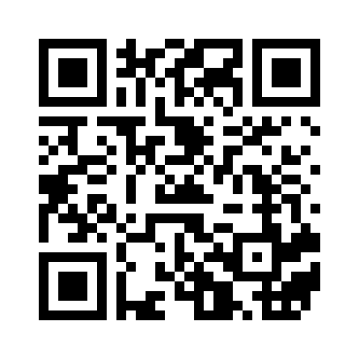
The myth of average
Todd Rose – TedX talk https://www.youtube.com/watch?v=4eBmyttcfU4
Notes:
Runs for 18 minutes
At the end ask for key messages that stood out from the video
Eg:
ban the average
no such things as average
Flexibility
plan to the edges

Slide 2
Notes:
The design of the Australian Curriculum provided the Australian Government, through (ACARA), the opportunity to develop a “high quality curriculum for all Australian students, one that promotes equity and excellence in education”.
The Australian Curriculum sets out what students will learn and teachers will teach through content and achievement standards as they progress through school from Foundation to Year 12. Every child has the right to access the full curriculum which means teachers continue to program from content that aligns with the child’s chronological age regardless of ability, disability or school setting.
ACARA does not have responsibility for how the curriculum is implemented however very deliberate efforts were made to design a curriculum to be inclusive of all students by applying the principles of UDL during the writing process. Specific examples will be given a little later in the presentation in relation to the HPE curriculum.

Slide 3
Key messages
No such thing as an average learner
By planning learning for the average we “miss” everyone
To plan for inclusion is to design to the edges
Needs to be proactive.

Slide 4
Jagged learner profile in HPE
Skill level
Language access
Reading ability
Notes:
What is the learner profile in HPE
e.g. movement skills
Spatial awareness
Language access – specialist language
Reading levels
Perceptual abilities
Cognitive abilities
Interest levels
Prior experiences
Background knowledge / learning
Tactical awareness
ACTIVITY:
2 sets of different coloured post-it notes
Broadly thinking about diverse needs in the class
Brainstorm at your table all the variables for a ‘jagged learner profile’
What are our “adjustable seats”
Now brainstorm as many different ways as you can think to support those needs if they are low or high and identify what are the implications for students learning and teachers practice.

Slide 5
“Adjustable seats” in HPE
Notes:
In his TEDx Talk Todd Rose talks about the solutions being like adjustable seats – its not about replacing everything we do but its about working out what the barriers might be to learning in HPE and how we can remove them from the learning environment.
Universal Design for Learning framework provides a tool we can usee to proactively provide adjustable seats for all of our learners.
What are our “adjustable seats”
Now brainstorm as many different ways as you can think to support those needs if they are low or high
identify what are the implications for students learning and teachers practice.

Slide 6
Notes:
The Australian Curriculum focuses efforts on ensuring all individuals have fair and equal opportunities to learn. In the Shaping Phase of the development of the Health and Physical Education curriculum it was explicitly identified that the UDL principles should inform the writing of the curriculum to ensure it was inclusive of all learners.

Slide 7
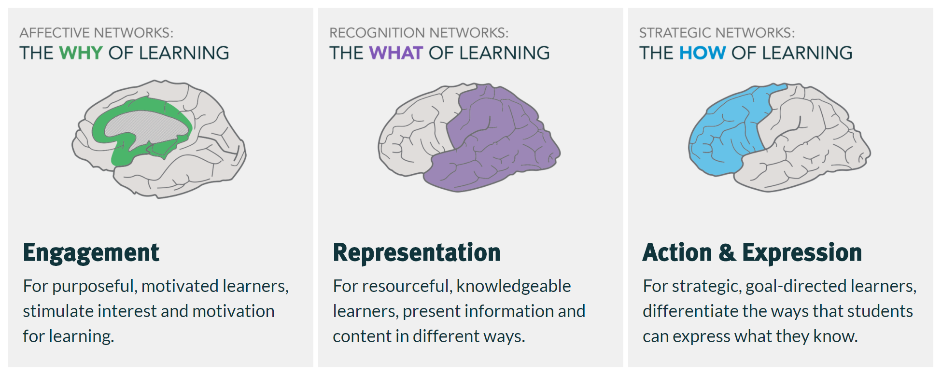
Universal Design for Learning
www.cast.org
Notes:
Universal design for learning (UDL) is a framework to improve and optimize teaching and learning for all people based on scientific insights into how humans learn. Refer to posters to indicate 3 principles with the guidelines and checkpoints].
During the writing phase of the Australian Curriculum, teams of writers work collaboratively with ACARA curriculum staff and are supported by expert advisory groups, including an advisory group for students with disability (ACARA, 2012b, p.14-15). “The curriculum writing process will involve advice and review of documents by advisory group members with expertise on inclusivity to ensure the appropriateness of curriculum content and expectations of achievement. (ACARA, 2013, p. 13)
Writers were briefed as part of their induction on the principles of UDL and how these could be applied to the way they worded content. Inclusivity checks were carried out at seven key points throughout the development of each subject (ACARA, 2012b). The intention was to remove barriers to learning and ensure enough flexibility to “…accommodate the reality of student, teacher and school diversity”

Slide 8
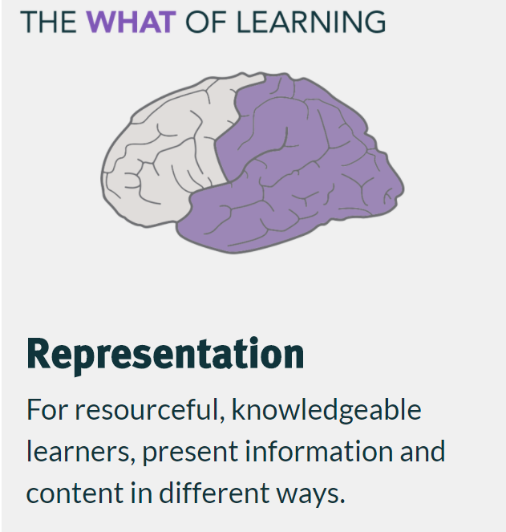
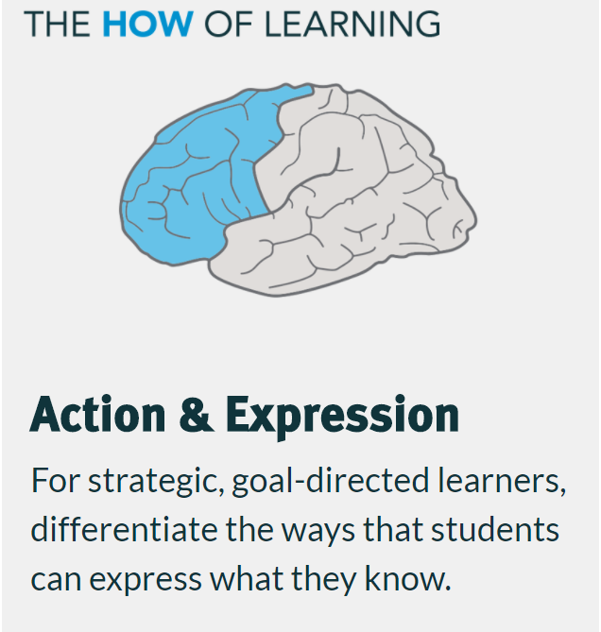
Before UDL lens
After UDL lens
drawing or collecting images of people who are special and important to them, and sharing and discussing their pictures with other students
identifying people who are special and important to them, and sharing and discussing their pictures with other students
Notes:
by changing the method or strategy it provides more opportunities for all students to participate in the learning activity.
The verb ‘draw’ is very specific. It limits how the teacher and student will engage with the content.
The verb ‘identify’ is open to much broader inclusive of students who may have limited communication skills who may rely on pointing or eye gaze to participate in the same learning activity.

Slide 9
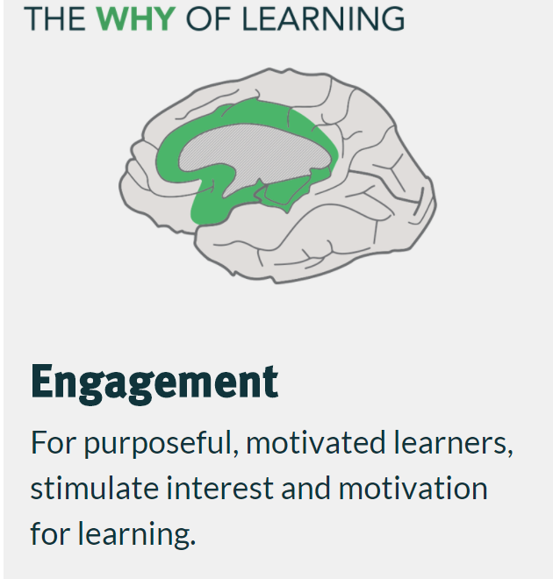
Before UDL lens
After UDL lens
performing a range of manipulative skills involving handling and controlling objects with the hands and feet or equipment such as overhand throw, ball bounce, two-hand side-arm strike, ….
performing a range of manipulative skills involving handling and controlling objects with the different parts of the body or equipment such as overhand throw, ball bounce, two-hand side-arm strike, move through water to safety
Notes:
by changing the expectations of how a task is performed it creates greater inclusivity and accessibility for all students.
The revision to the content acknowledges and respects that not all students will use their hands or feet and establishes the expectation that all students will participate in this movement strand.

Slide 10
Principles
Guidelines
Checkpoints

Slide 11
UDL wheel = “adjustable seats”
Is there more than one way that students can engage with this lesson?
Is there more than one way that you can teach the lesson?
Is there more than one way that students can demonstrate what they have learnt from the lesson?
Notes:
Think pair share activity
Coloured post-its
Think about the question you’ve been given and apply it to your program (10 mins)
annotate your program with as many examples that you can think of
Pair up with someone who has looked at the same principle and list some general examples on you post-it.
Individual groups feedback to the whole group – collect examples on to butcher’s paper and leave with the school as a resource that they may wish to refer to

Slide 12
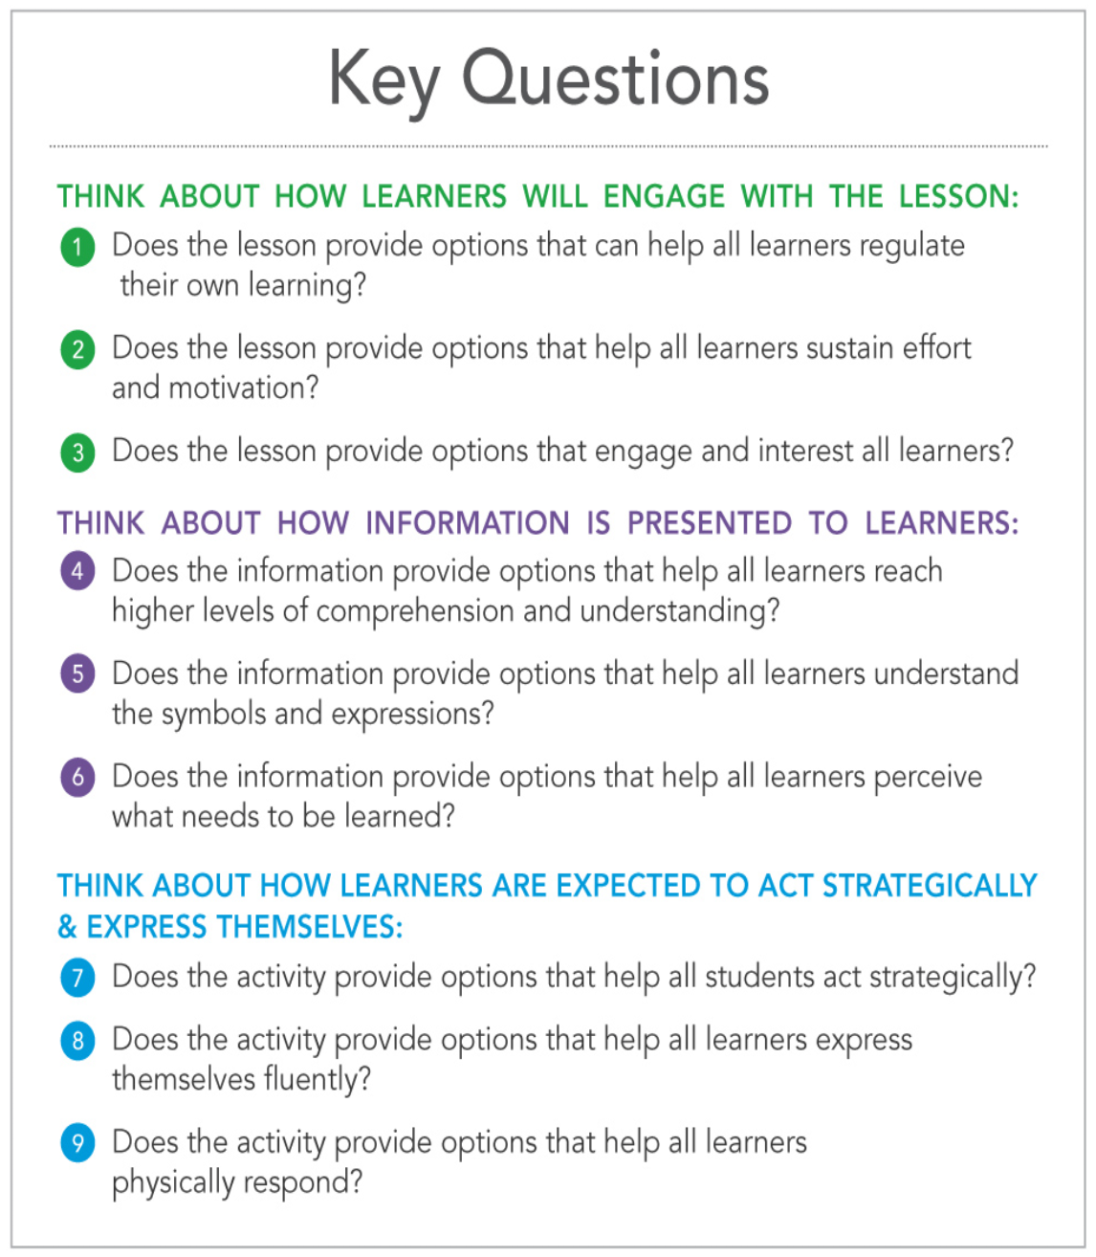
Tools for planning inclusive lessons

Slide 13
