Slide 1
Developing inclusive programs
Session 5

Slide 2
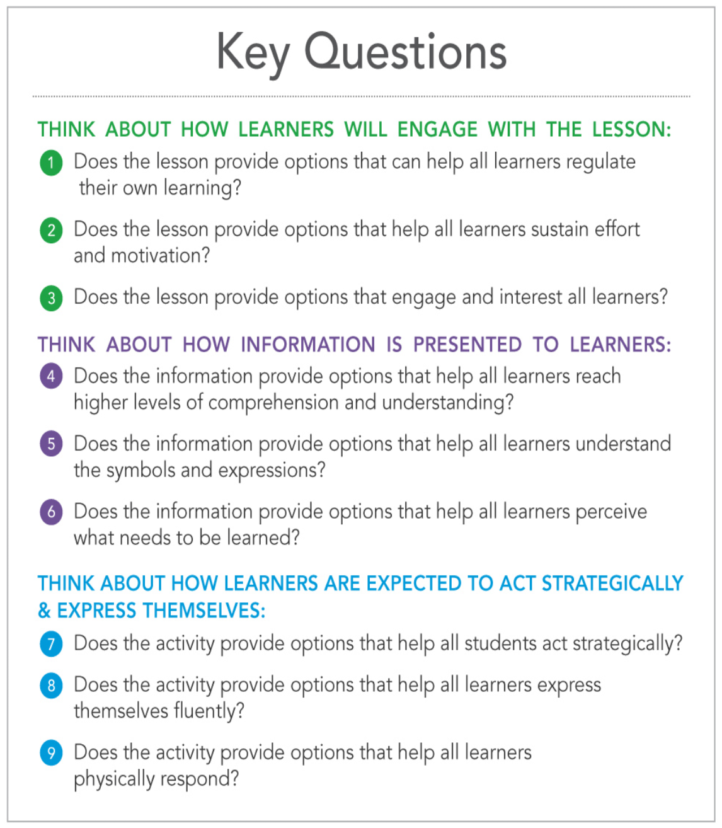
Tools for planning inclusive lessons

Slide 3
